Slide 1
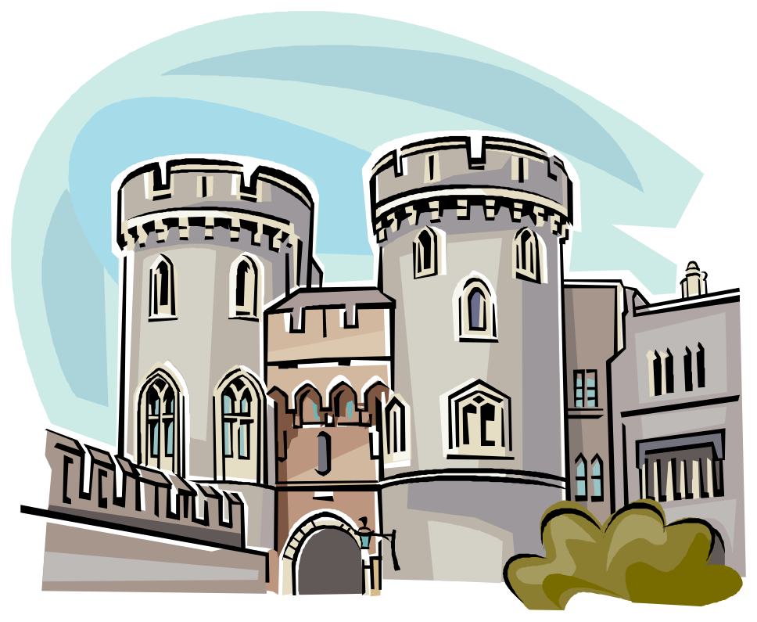
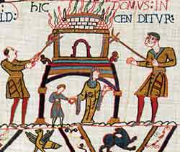
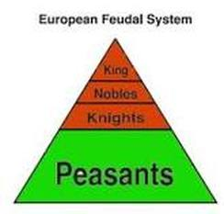
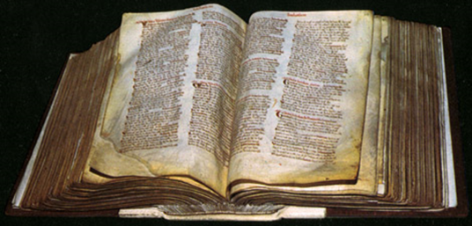
What do you already know about the impact of the Normans on Britain? You studied this in Y7!
Use the vocabulary and pictures below to help you.
Prepare for Learning
Norman Conquest Rebellion
Harrying of the North Castles
Feudal System Domesday Survey
Challenge: how might these changes influence crime, law and punishment?

Slide 2
Learning Objectives
To work effectively as a group to select information and design a game to enable pupils to explain the changes of the Norman Conquest
Identify and describe events and changes of the Norman Conquest (L1/2)
Explain events and changes of the Norman Conquest (L3)
Explain links between changes under the Normans and changes in crime and punishment (L3+)

Slide 3
New information
Watch the Horrible Histories clips to investigate the impact of the Normans on Britain. Consider how these factors might impact on Crime and Punishment:
Norman Conquest: http://www.youtube.com/watch?v=G4iMQcz1YDQ
Conquest news report : http://www.youtube.com/watch?v=r2hJAwdByYE
William the Conqueror: http://www.youtube.com/watch?v=bQ8A5gRe_Dw
Rebellions: http://www.youtube.com/watch?v=IASf8QzOFJo
Domesday Survey: http://www.youtube.com/watch?v=aTIon_U9jik
Castles: http://www.youtube.com/watch?v=BtaRI1UD0y0
Norman words: http://www.youtube.com/watch?v=ANR8OdxHoKM

Slide 4
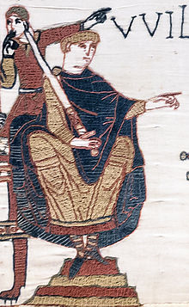
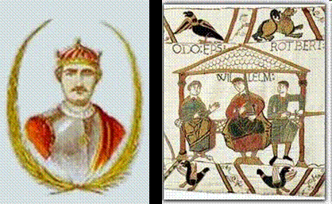
William successfully invaded and took control of England. He was crowned king on Christmas Day 1066.

Slide 5
He built castles from 1066
This meant that rebellions could be dealt with quickly and criminals could be locked up in dungeons

Slide 6

He put down rebellions
He carried out the Harrying of the North in 1069.

Slide 7
He started the Feudal System
There was not such a large difference between Norman and Anglo-Saxon society as there was between Roman and Anglo-Saxon society. Lots of things stayed the same. The main differences were:
1. Increased power of the king
2. Increased power of the church (see next lesson)

Slide 8
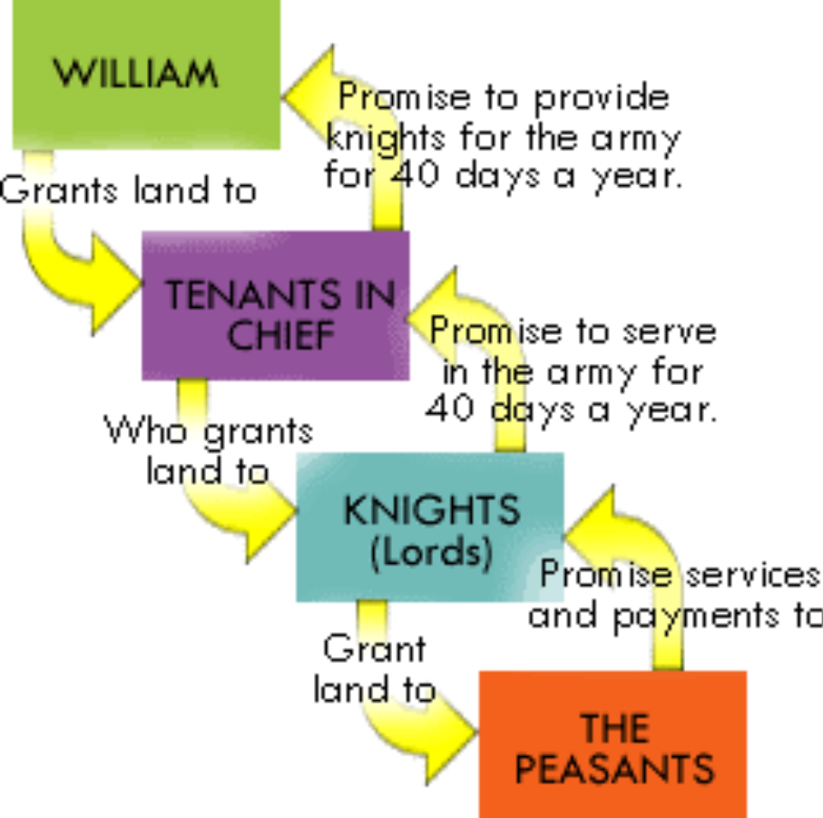
Society: Themes across time
This provided him with an army and made sure the population was kept under control

Slide 9

He needed to collect tax
This meant he had to know how much land, property, animals and money each person owned.
Each person had to give one tenth of what they’d earned or produced as a tax called a ‘tithe’

Slide 10
How could he find out what people owned or earned?
Ask them, and keep a record of it! Simple!

Slide 11

This record was called the ‘Domesday Book’ 1086

Slide 12
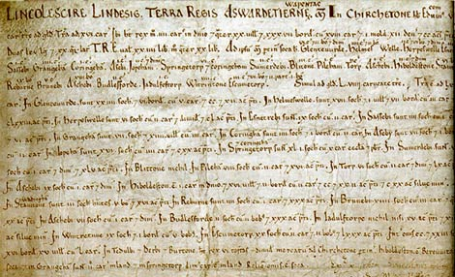
Every town and village was recorded, along with what it’s inhabitants owned or produced.

Slide 13
Construct
Work as a group to produce an invasion game based on key information about the Norman Conquest. The aim of the game is to conquer England by explaining key ideas about the Norman Conquest.
    Normanopoly : http://www.youtube.com/watch?v=qI8jsVE0qEQ

Slide 14
Your task in pairs or small groups is to design a board game to show the changes/impact of the Norman Conquest.
You also need to produce an information leaflet to accompany your game to inform people about the topic and to display the rules of the game.
REMEMBER: Your board game needs to be educational as well as looking good.

Slide 15
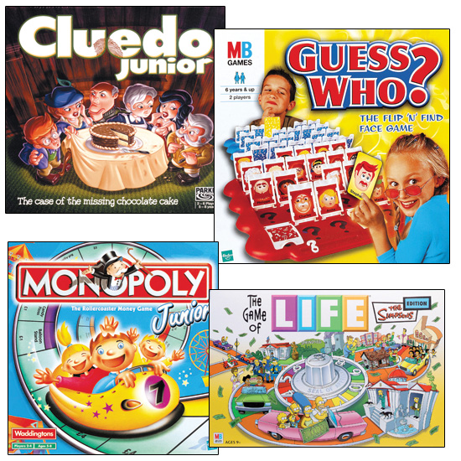

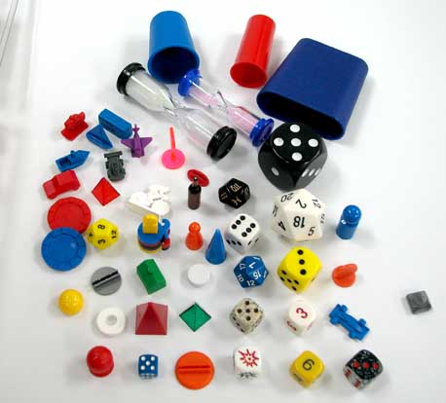

Slide 16
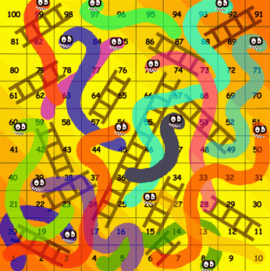
A good way to show change and continuity – things that have changed and things that have stayed the same – would be a game of snakes and ladders…it will show the ups and downs, changes and continuities of life in Britain

Slide 17
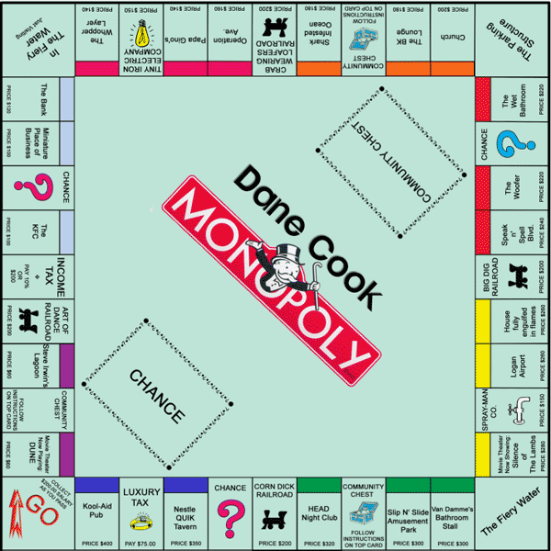
A monopoly style game would be a good way to show ideas about invasion and conquering

Slide 18
What's the aim of the game?
The objective of the game is to…
To play this game you need to…
To win this game you need to…
To be successful at this game you need…
The rules of the game are…

Slide 19
Look at the levels below again:
Identify and describe events and changes of the Norman Conquest (L1/2)
Explain events and changes of the Norman Conquest (L3)
Explain links between changes under the Normans and changes in crime and punishment (L3+)
What level are you working at? Where do you need to be by the end of the year?
Aim high – aim for your target level
What do you need to do in order to reach that target?

Slide 20
Success Criteria
You need to establish your success criteria in order to make your game…you’ve guessed it…successful!
historical details
change
continuity
Impact of the Normans
Influence on crime, punishment and law?
Presentation
Successful group work

Slide 21
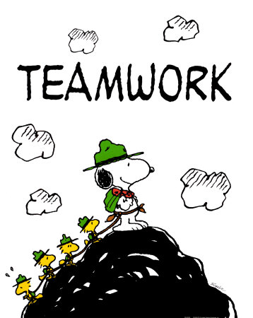
Effective group work
Agree what the task is about (talk together to decide what the outcome will be)
Talk through and decide a way forward (discuss and make decisions)
Work together to complete each part of the task (focus and cooperate)
Review your work (how well have you done?)

Slide 22
Stretch and challenge
How might Norman events and changes impact on law?
A declaration made by William 1 in 1070: “I will that all men who have come with me from Normandy will be protected by my peace… if one of them is killed his murderer’s lord shall capture the slayer and if they can’t they should pay 46 marks of silver to me”

Slide 23
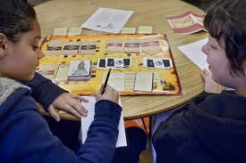
Apply
Play each other’s games in a sensible manner.

Slide 24
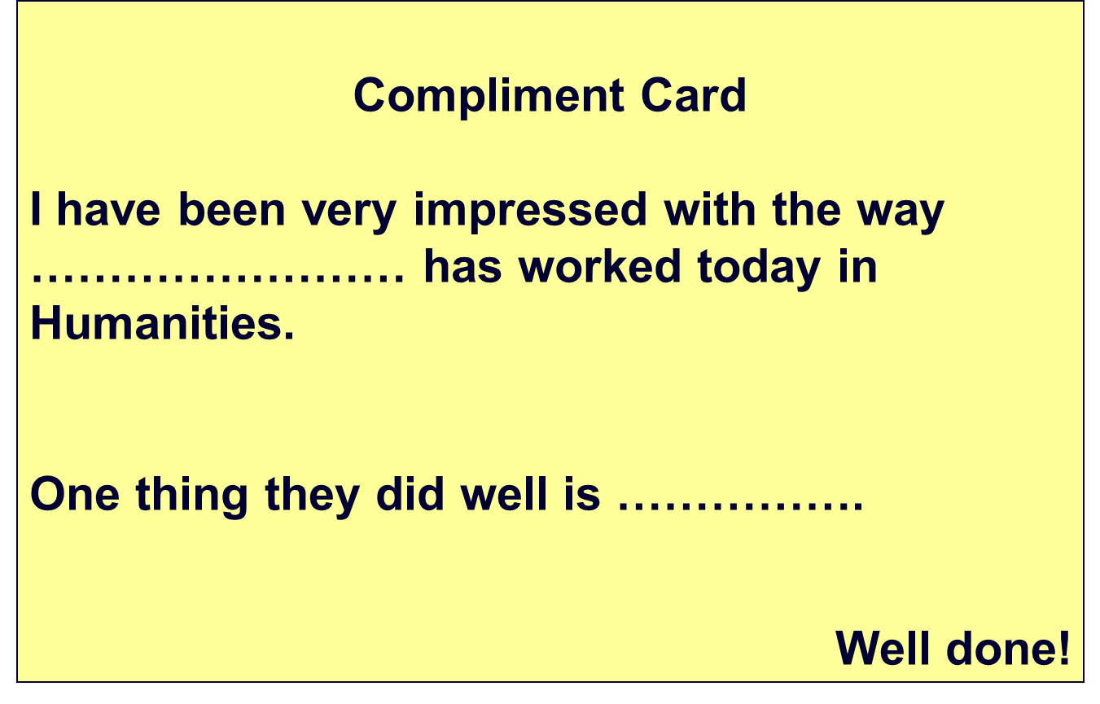

Review
Complete the compliment card for the group whose game you played. What have you learnt about the
Impact of
The
Normans?
How might it
Influence
Crime and
Punishment?

